Slide 1

Advanced 32-bit ALU with RAM, CU, and Program Counter Integration

Slide 2
INTRODUCTION TO ALU
INTRODUCTION TO RAM
ALU stands for Arithmetic Logic Unit. It is a fundamental component of the CPU.
Performs arithmetic operations like addition and subtraction.
Executes logic operations like AND, OR, XOR, and NOT. Operates on binary input data (usually two operands).
Plays a crucial role in data processing and decision-making.
Can be integrated with memory (RAM) for data storage and retrieval.
Used in all digital systems—from simple microcontrollers to complex CPUs.
Integrated RAM provides temporary storage for operands and results within the ALU system.
It is typically a small memory array (e.g., 256 x 32-bit) with read/write capabilities.
ALU reads input data from RAM, performs operations, and writes the result back.
Controlled using signals like address, write_enable, data_in, and data_out.Mimics how a real processor interacts with memory for instruction and data processing.
Enables efficient data flow, testing, and operation sequencing in ALU-based designs.

Slide 3
WHY WE NEED EXTENSION ON THIS?
1. Automation of Instruction Execution
A standalone ALU + RAM setup requires manual control for each operation.
Without a Control Unit, the system can't interpret or execute instructions on its own.
The extension allows for automatic instruction fetching, decoding, execution, and storing—just like a basic CPU.
2. Sequential Execution with Program Counter
The Program Counter (PC) keeps track of which instruction to execute next.
It automatically increments to point to the next instruction, enabling step-by-step execution.
Without a PC, each instruction has to be manually triggered, which is inefficient and unrealistic for real-world systems.

Slide 4
WHY WE NEED EXTENSION ON THIS?
The Control Unit (CU) interprets the operation code (opcode) and generates the required control signals.
These signals guide the ALU and RAM on what to do—like whether to perform addition, load data, or store results.
CU acts like the brain of the system, managing operations based on the instructions.
In modern processors, execution is based on a cycle:
Fetch → Decode → Execute → Store.
By adding a CU and PC, we replicate this architecture and lay the foundation for a real programmable processor.
The extension with Control Unit and Program Counter transforms a basic calculator-like ALU into a smart, instruction-driven mini-processor capable of sequential and conditional execution—bringing it closer to how real-world CPUs operate.

Slide 5
CONTROL UNIT
Heart of the CPU:
Controls and directs all operations inside the CPU.
Instruction Decoder:
Reads and understands the instructions from memory.
Generates Control Signals:
Sends signals to ALU, RAM, and PC to perform tasks in the right order.
Controls Data Flow:
Manages how data moves between CPU, memory, and I/O devices.
Ensures Synchronization:
Makes sure all parts of the CPU work together with each clock cycle.

Slide 6
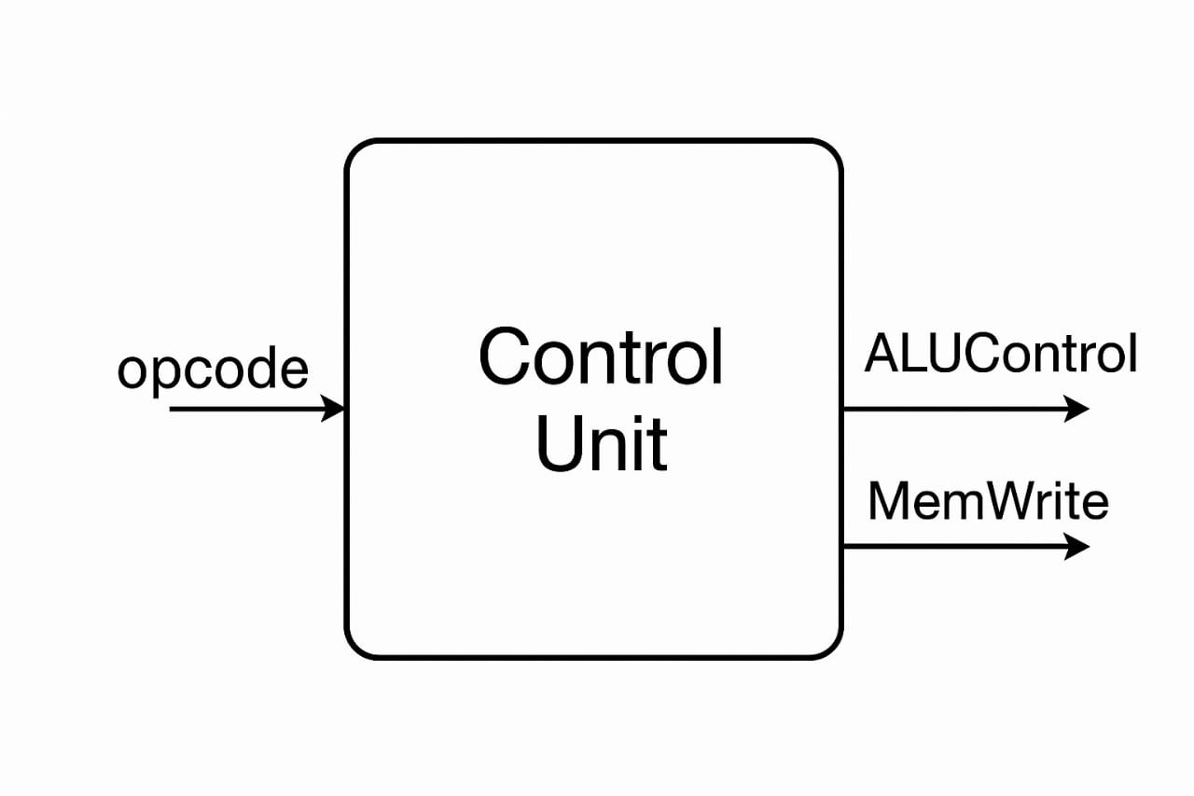

Slide 7
PROGRAM COUNTER
Tracks Instruction Location:
Holds the address of the next instruction.
Increments Automatically:
Moves to the next instruction after each execution.
Supports Jumps and Branches:
Updates address during loops or condition changes.
Controls Program Flow:
Helps run instructions in the right order.
Works with Control Unit:
CU uses PC to fetch instructions smoothly.

Slide 8
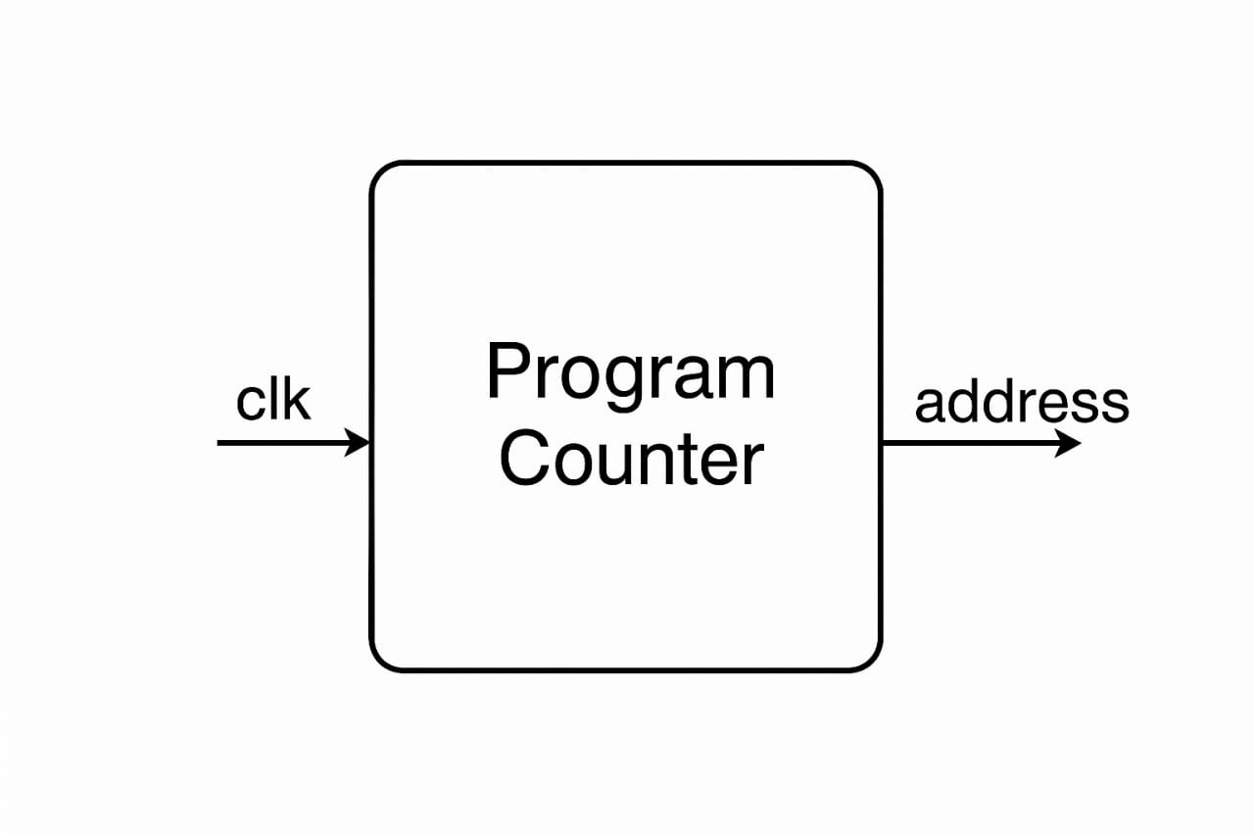

Slide 9
HOW DOES THE WHOLE SYSTEM WORK?
PC gives the address of the instruction to be executed.
Instruction is fetched from ROM (or instruction memory).
CU decodes the instruction and understands what operation is to be done.
CU sends control signals to ALU and RAM.
ALU performs the operation (e.g., ADD two values from RAM).
Result is stored back in RAM.
PC moves to the next instruction automatically, and the cycle continues.

Slide 10
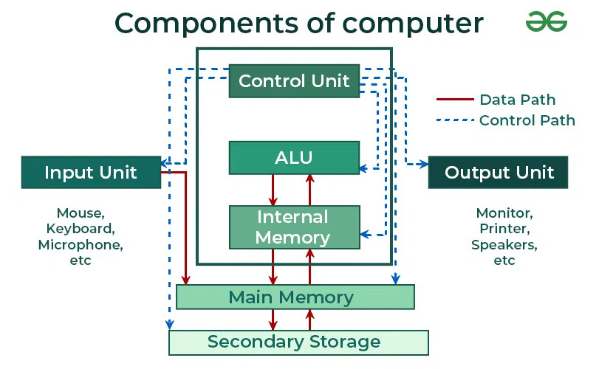

Slide 11
INSTRUCTION EXECUTION CYCLE
Fetch: Instruction read from ROM via PC
Decode: CU interprets instruction and prepares control signals
Execute: ALU performs the operation
Store: Output written back to RAM
Fetch → Decode → Execute → Store.

Slide 12
DESIGN CODE
This project is a basic CPU design made using Verilog HDL. It includes four main parts: a 32-bit ALU, RAM, a Control Unit (CU), and a Program Counter (PC).
The ALU performs operations like addition, subtraction, AND, OR, etc., based on control signals.
The RAM works as memory, storing data temporarily and either reading or writing based on a control signal.
The Control Unit reads the instruction (opcode) and sends signals to the ALU and RAM to tell them what to do.

Slide 13
The Program Counter keeps track of which instruction is being executed and moves to the next one automatically.
All these parts are connected in the TopModule, which controls how data flows and how instructions are carried out one after another.
This setup shows how a simple CPU fetches, decodes, executes, and stores instructions step by step.

Slide 14
TEST BENCH CODE
The testbench is used to check how all parts of the mini CPU system—ALU, RAM, Control Unit, and Program Counter—work together inside the TopModule.
It starts by setting up the inputs like clock, reset, opcode, operands (A and B), and memory address.
A clock signal is created using an always block that flips every 5 nanoseconds to simulate real-time behavior.
First, the system is reset, and then different instructions are tested one by one.
Each instruction uses a 3-bit opcode, along with values for A, B, and an address.

Slide 15
The testbench checks operations like ADD, SUB, AND, OR, and storing the result in memory.
The ALU does the calculations, the Control Unit sends the right signals, and RAM stores or reads data.
The Program Counter updates automatically to move to the next step.
The results, such as the ALU output, memory data, and PC value, are shown using $display for easy verification.
This helps make sure all parts of the system are working correctly and in order.

Slide 16
BENEFITS OF THE ADVANCED 32-BIT ALU
Works Like a Mini Processor
Follows Instructions Automatically
Stores and Uses Data Quickly
Simulates Real CPU Behavior
Supports Sequential and Conditional Execution
Increased Functionality and Complexity Handling
Better Simulation of Real-world Processors
Enhanced Data Storage and Retrieval
Improved Instruction Execution Capability

Slide 17
CONCLUSION AND FUTURE SCOPE
Successfully enhanced the 32-bit ALU system by integrating the Control Unit (CU) and Program Counter (PC).
Established a strong foundation for building a simple, programmable CPU capable of executing instructions and managing data flow.
Future Scope:
Add instruction memory for storing programs separately.
Implement pipelining to improve processing speed and efficiency.
Introduce interrupt handling for better control and responsiveness.
Integrate input/output (I/O) ports to communicate with external devices.

